Slide 1
SD Card
Speaker: Richard Chen
Team: Firmware
Report Date: 2014/4/14 – 4/18

Slide 2





Structure
SD Card
Host Controller

Slide 3
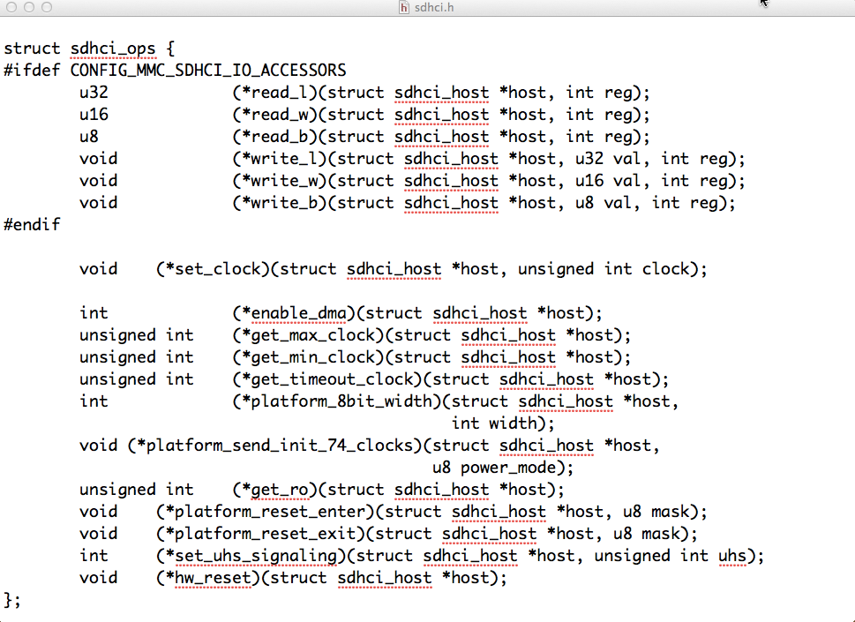


Host
SD Card Host Controller
Initial Set for SD Card
Register a Host to MMC

Slide 4
Core
MMC Initial
Scan and Rescan Device
Maintain command process
Key program:
core.c(mmc_init, mmc_rescan)
mmc_ops.c(mmc commands)
sd_ops.c( sd commands)
sd.c ( attach and initial sd)

Slide 5
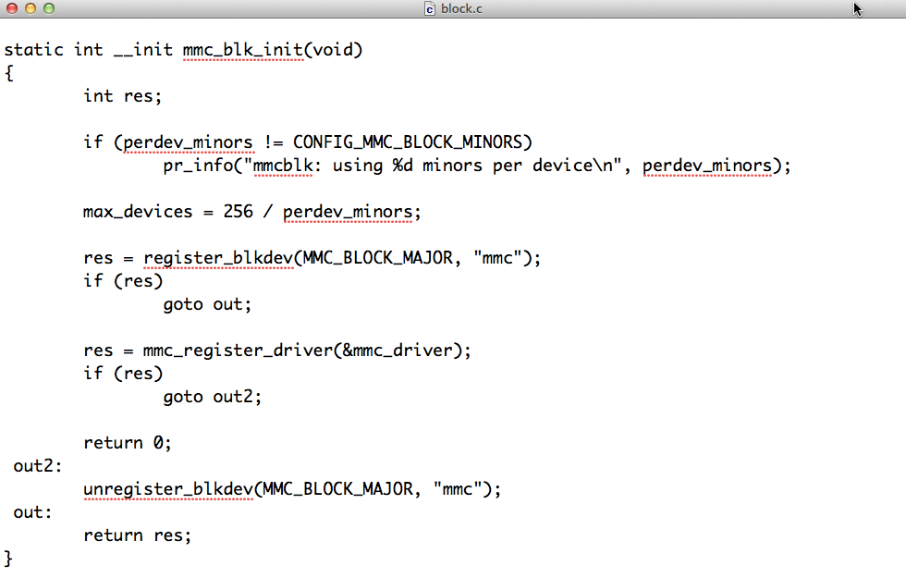


Card
MMC Block Device Register
(Ioctl)
Queue

Slide 6
SD Working Process
STEP1: mmc_init [core/core.c]
STEP2: mmc_blk_init [card/block.c]
STEP3: ftsdc021_probe [sdhci-ftsdc021.c]
STEP4: mmc_rescan [core/core.c]
Start to Attach Card and Init
STEP5: mmc_attach_sd [core/sd.c]
STEP6: mmc_sd_init_card [core/sd.c]

Slide 7
SD Working Process
CMD0 : Reset all card to idle
STEP7: mmc_go_idle [core/mmc_ops.c]
CMD8 : Compare SD Card Version
STEP8: mmc_send_if_cond [core/sd_ops.c]
CMD55 and ACMD41:
STEP9: mmc_send_app_op_cond [core/sd_ops.c]

Slide 8
SD Working Process
CMD2 : Ask CID Number
STEP10: mmc_all_send_cid [core/sd_ops.c]
CMD3 : Ask Relative Address
STEP11: mmc_send_relative_addr [core/sd_ops.c]

Slide 9
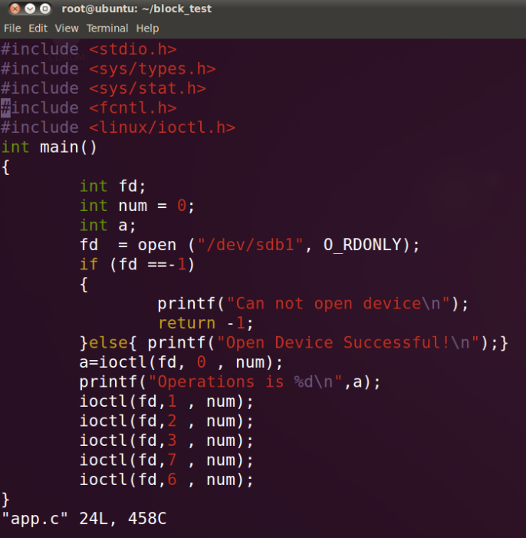


Ioctl Test
MMC Ioctl Test and Debug Print

Slide 10
Ioctl Test Result
Dmegs Result
Program a.out is using a deprecated SCSI ioctl, please convert to SG_IO.
Can not add cmm I/O control.

